Slide 1

Sparks Analysis Report Oct-Dec’24
Presented by Simarleen Kaur Dung
Student at University of Bristol

Slide 2
Introduction
This report has been created for Sparks, the Sustainability and Arts Hub.
The report aims to provide knowledge about how the attitudes and needs of people might change in different areas.
The data used, has been collected via a survey form from people living in different postcodes.
A total of 39 people have responded.
The number of respondents for each question varies, as not everyone answered every question. Please bear this in mind when looking at the stats.
The key findings have been highlighted in the upcoming slides.

Slide 3
Contents
Demography
Recommendations for the City Centre
Popularity of Cabot Circus
Views on Creativity
Environmental Awareness
Popularity of Sparks

Slide 4
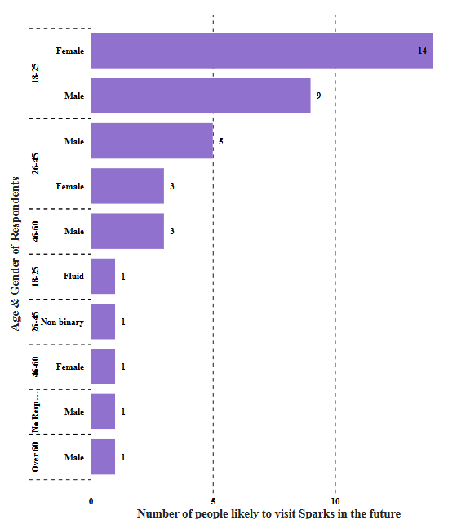
I. Demography
The key demographic factors considered are Age, Gender, Ethnicity, Disability and Area of residence.
The adjacent figure shows the number of people likely to visit Sparks, based on the age and gender distribution of the respondents.
We can see that a majority belongs to the 18-25 age group, with more females than males. With age, the number of respondents keep decreasing.
The graph is positively skewed, suggesting that Sparks has a strong appeal among younger individuals, especially females, but lower interest among older age groups.
This insight can guide marketing, branding and service improvements to either reinforce the existing audience or broaden appeal to other groups.

Slide 5
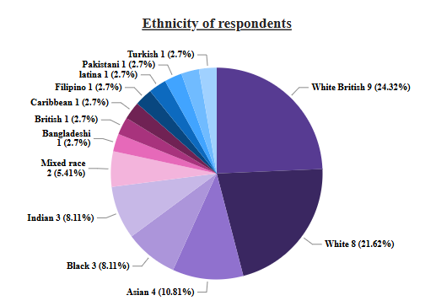
The adjacent pie chart shows the various ethnicities that the respondents belong to, a majority of them being White British followed by White.
Other significant groups such as Asian, Indian and Mixed Race also have a notable response.
Although there is a diverse mix of ethnicities present, the low representation of Caribbean, Filipino, Latina and Pakistani respondents suggests that Sparks might have limited engagement with these communities.
If Sparks aims to increase diversity in its audience, targeted outreach efforts may be needed to attract underrepresented ethnic groups

Slide 6
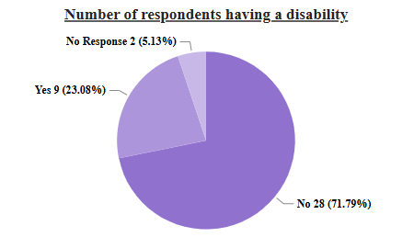
The adjacent pie chart shows that majority respondents do not have a disability.
Since 23% of respondents have a disability, Sparks should ensure its facilities, services and events are accessible.
Consider improving accessibility features such as ramps, elevators, assistive services etc.
Engaging with this community through inclusive marketing and accessibility-focused initiatives could increase participation.

Slide 7
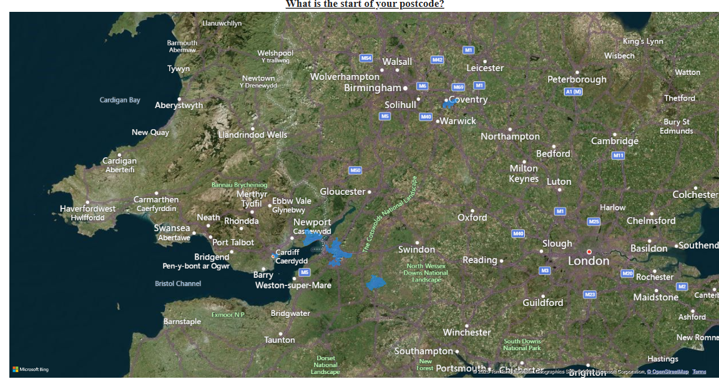
The adjacent map shows the areas of residence of the respondents.
We can see that a majority of them are in and around Bristol.
There are a significant number of people from nearby cities like Wales and Trowbridge.
There are also a few people from Coventry.
This indicates a vast diversity of areas covered during the survey

Slide 8
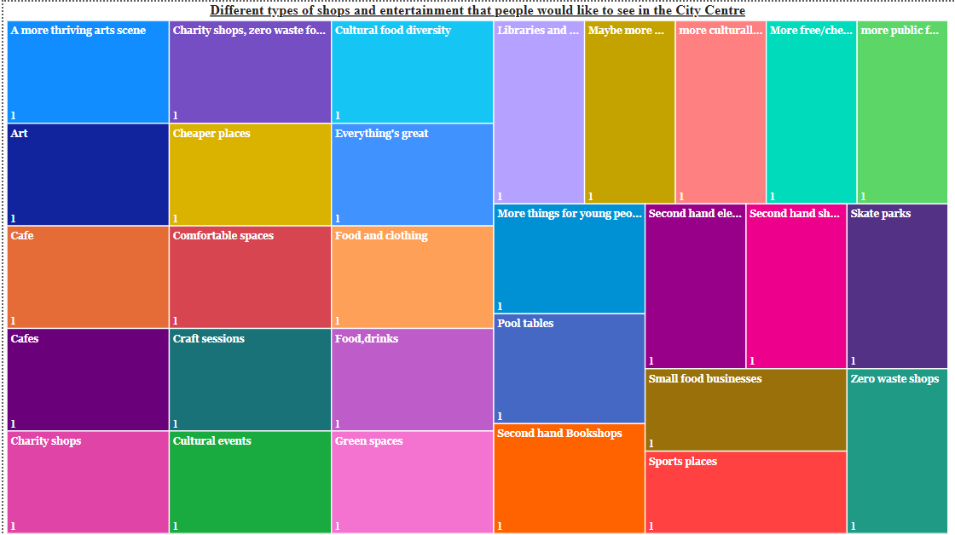
II. Recommendations for the City Centre
The adjacent visualization shows the various types of activities, shops, or experiences that the public would like to see more of in Bristol’s city centre.
The responses cover a broad range of interests, including food, culture, arts, second-hand shopping, green spaces, and recreational areas.
Encourage local businesses to offer diverse and affordable food options
Increase investment in public and cultural spaces, including libraries, art hubs, and green spaces.
Promote sustainable shopping through second-hand and zero-waste initiatives.
Expand entertainment and recreational areas, particularly for young people and social engagement.

Slide 9
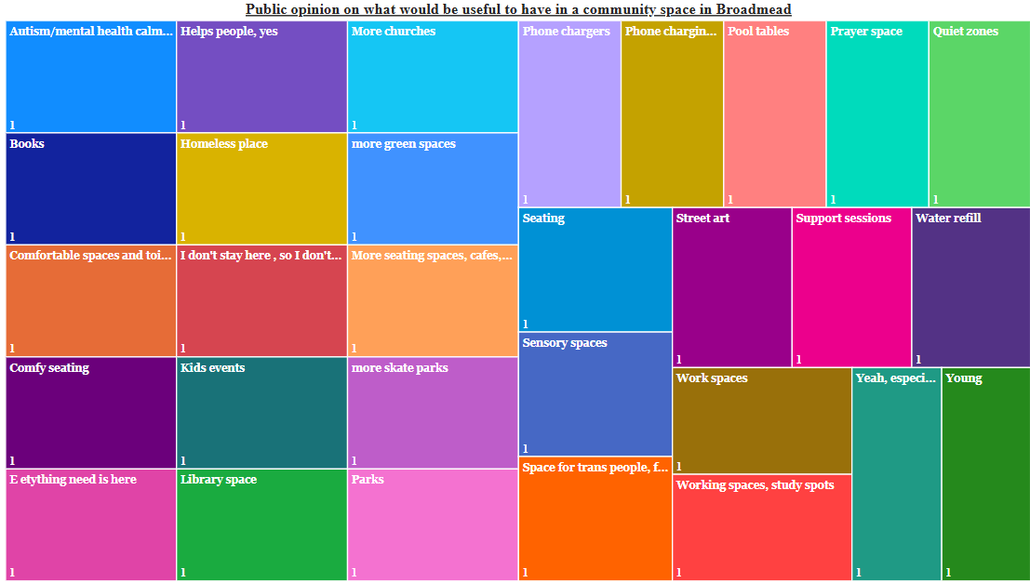
The adjacent visualization shows people’s opinions on the various types of things that might be useful to have in the community space in Broadmead.
Expand seating and communal spaces to foster a more comfortable and social environment.
Improve accessibility to mental health and homeless support services within community spaces.
Enhance recreational options for children and young adults through parks, sports areas, and cultural activities.
Promote sustainability by incorporating water refill stations and green spaces.

Slide 10
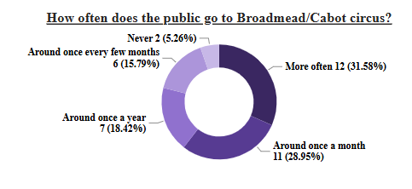
III. Popularity of Cabot Circus
The adjacent donut chart indicates how often people visit Broadmead or the Cabot Circus.
Maximum number of people visit quite often, followed by those who visit once a month. Together these two categories account for 60.53% of responses, indicating that a majority visit at least monthly.
Strategic Actions for Sparks can include leveraging City Centre Traffic:
Position Sparks as a must-visit destination for people who already frequent Broadmead/Cabot Circus.
Run targeted promotions to convert occasional visitors into frequent ones.
Engaging with the "Once-a-Year" Visitors:
Offer seasonal events, exclusive workshops, or annual memberships to encourage repeat visits.
Capitalizing on Footfall Patterns:
If visitors come more often on weekends or during special events, Sparks should plan key attractions around these peak times.

Slide 11
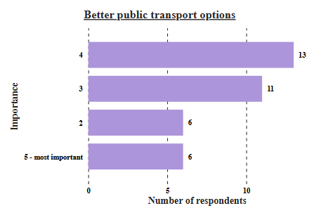
The adjacent visualization shows the importance of Better transport options to and from the city centre.
19 out of the total respondents feel that this is a major factor which if improved, would improve the footfall in the centre.
There is a significant number of people who think this issue is of moderate importance.
For Sparks, this could imply that, because the public does not have access to good public transport options, they are unable to visit the centre that often hence impacting the number of people coming to Sparks.

Slide 12
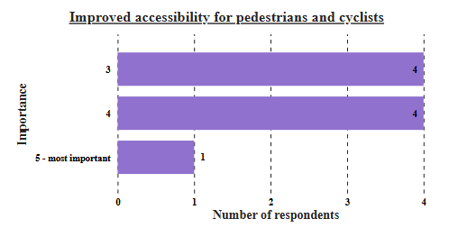
The adjacent visualization shows the importance of improved accessibility for pedestrians and cyclists.
Although very few people have responded to this question, we can infer that this issue is of significant importance to people who prefer walking or cycling to their destinations.
For Sparks, this could imply that, because accessibility to the centre is not that good for pedestrians and cyclists, people prefer to visit the centre less frequently, hence impacting the footfall in Sparks.

Slide 13
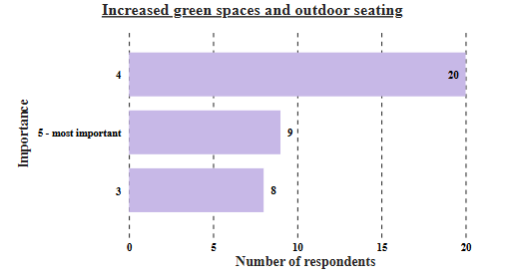
The adjacent bar graph shows the importance of increased green spaces and outdoor seating in the city centre.
We can see that 29 people from the total number of respondents have voted for a higher level of importance
The absence of bars for categories ‘2’ and ‘1’ which imply ‘less important’, stresses on the fact that improvement in this area could significantly impact people’s opinion about the city centre
For Sparks, this could be a direct benefit considering that it is located at a prime location of the city centre.

Slide 14
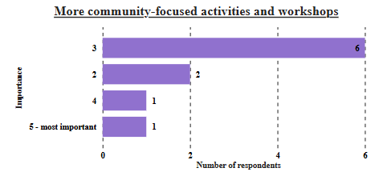
The adjacent bar graph shows the importance of having more community-focused activities and workshops.
We can see that maximum number of respondents have voted for category ‘3’ indicating that this factor is of moderate importance to the public

Slide 15
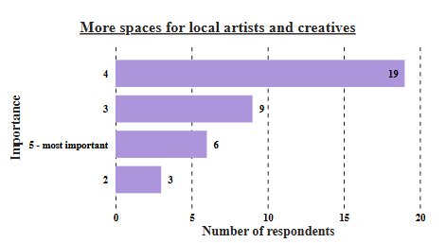
The adjacent bar graph shows the importance of having more spaces for local artists and creatives in the city centre.
We can see that 25 people from the total number of respondents have voted for a higher level of importance
9 people have voted for category ‘3’ indicating that this factor is of relatively higher importance and might help attract more public to the centre, if they are provided a platform to showcase their talent
The absence of a bar for category ‘1’ which implies ‘less important’, stresses on the fact that improvement in this area could positively impact footfall in the city centre
For Sparks, this could be a direct benefit considering that it is located at a prime location of the city centre.

Slide 16
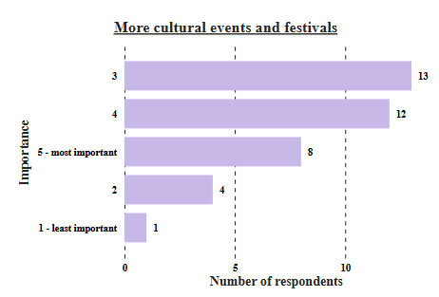
The adjacent bar graph shows the importance of having more cultural events and festivals in the city centre.
We can see that 20 people from the total number of respondents have voted for a higher level of importance
13 people have voted for category ‘3’ indicating that this factor is of relatively higher importance and might help attract more public to the centre
If we recall our inference from the demographic data, a large number of our respondents consist of young adults. It could be directly correlated that having more cultural events and festivals will attract youth from in and around the city.

Slide 17
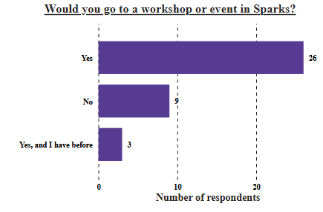
The adjacent visualization shows whether the respondents would visit Sparks for a workshop or event.
A huge majority has voted in favour and some have also attended events in the past.
This can be considered as a very positive response for Sparks also indicating that Sparks has a good reputation among the general public.
Foe those who have voted ‘No’, the most common reason given was that they ‘do not stay near the city centre.’

Slide 18
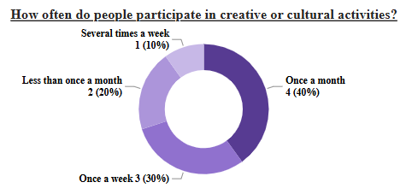
IV. Views on Creativity
The adjacent visualization shows how often does the public engage in creative and cultural activities.
"Once a month" is the most common response, with 40% of people participating in creative or cultural activities at this frequency. This suggests a regular, but not overly frequent engagement with such activities.
Lifestyle and priorities: Those who participate weekly might prioritize creative and cultural activities in their lives more than those who participate less frequently.
Accessibility and resources: The frequency of participation could be influenced by factors such as access to cultural events and resources, as well as personal finances and time constraints.

Slide 19
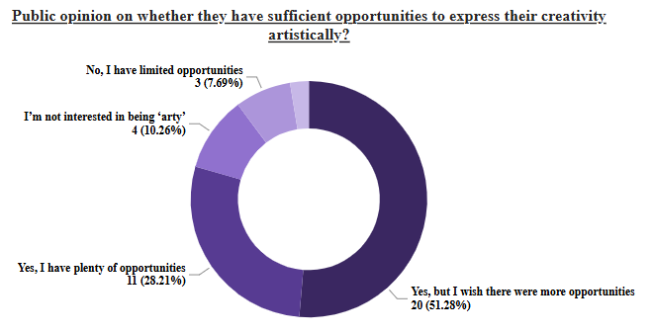
The adjacent donut chart shows public opinion on whether they have sufficient opportunities to express their creativity artistically.
High unmet demand: The data suggests a significant desire for more opportunities for artistic expression. This implies a strong potential audience for creative workshops, classes, and events offered by organizations like Sparks. Encourage local businesses to offer diverse and affordable food options
Target audience for Sparks: The 51% who want more opportunities, along with the 28% who have limited opportunities, represent a key target audience for Sparks' Sustainability and Arts Hub. These individuals are clearly interested in creative activities but lack sufficient outlets. Promote sustainable shopping through second-hand and zero-waste initiatives.

Slide 20
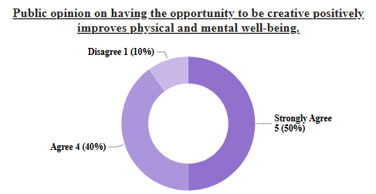
10% Strongly Agree: A small fraction of people are highly convinced that creative opportunities boost well-being.
50% Agree: Half the people see a positive link between creativity and well-being, though with less strong conviction.
40% Disagree: A large minority doesn't believe creativity improves well-being.
Implications for Sparks:
Marketing: Emphasize the well-being benefits of creativity to attract the "Agree" group, while potentially addressing the "Disagree" group's concerns.
Programming: Offer diverse activities to cater to varying beliefs and interest levels, including potentially those who are already "strongly agree" and want more advanced opportunities.
Community Engagement: Sparks could facilitate discussions or workshops to explore the different perspectives on creativity and well-being, fostering a more inclusive environment.

Slide 21
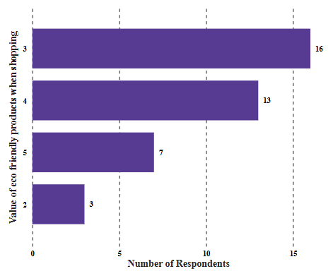
V. Environmental Awareness
The adjacent bar graph shows the value of eco-friendly products while shopping.
The responses cover a broad range of views. Maximum respondents have indicated higher value of eco-friendly products
Educate and inform: Provide information about the eco-friendly attributes of products to help consumers make informed choices and potentially increase the perceived value of these items. This could bridge the gap between stated value and actual purchase.
Consider partnerships: Collaborating with brands known for sustainability could enhance Sparks' image and attract eco-conscious consumers.

Slide 22
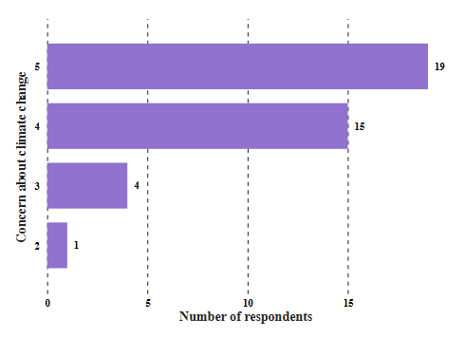
In the adjacent visualization, The data shows a strong concern about climate change among respondents, with the majority (19 out of 25) being very concerned (rating 5) and a significant portion (15 respondents) also being quite concerned (rating 4). Lower levels of concern are much less frequent.
Sparks should consider partnering with local environmental groups or participating in initiatives that address climate change. This can strengthen Sparks' image as a responsible and engaged member of the community.
Align with values: Sparks should strongly emphasize its commitment to sustainability and environmentally friendly practices, as this aligns with the high level of concern about climate change shown by the respondents.

Slide 23
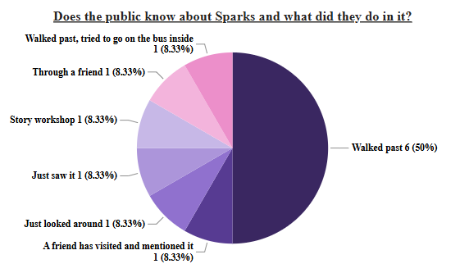
VI. Popularity of Sparks
The data reveals that "Just saw it" is the primary way people know about Sparks, accounting for 50% of responses. All other avenues, including word-of-mouth, workshops, and actively seeking it out, represent only 8.33% each. This suggests that Sparks has high visibility (people are "seeing" it), but low engagement or knowledge beyond basic awareness.
Sparks needs to capitalize on its visibility by converting passive viewers into active participants. This could involve:
Clear Signage and Information: Ensure signage clearly communicates what Sparks is and what it offers. People "seeing" it should quickly understand its purpose.
Eye-Catching Window Displays/Activities: Create engaging window displays or host visible activities that draw people in beyond just "seeing" it.
Promotional Materials: Have readily available brochures or flyers that people can grab as they walk by, providing more information.

Slide 24
Conclusion
Sparks benefits from high visibility, with half the public recognizing its presence. However, this awareness hasn’t translated into strong engagement, highlighting both an opportunity and a challenge. The diverse public interest in cultural events, charity shops, green spaces, and affordable options suggests that Sparks must position itself as a dynamic community hub. Improved signage, interactive displays, and accessible information can help convert passive viewers into active participants. Additionally, targeted outreach, advertising, and a strong social media presence can enhance understanding. Encouraging word-of-mouth through memorable experiences will ensure Sparks evolves from just being “seen” to being deeply engaged with.

Slide 25
Thankyou!

